Slide 1

CIGS Based Multi-Junction Solar Cell
“Enhancing efficiency by inserting SnS Layer”
Presentation by:
Ranjan Yadav
EVD17I009
under the guidance of:
Dr. Vivek Kumar
Photovoltaic Science & Engineering
PHY-507T
Department of ECE
Indian Institute of Information Technology
Design and Manufacturing Kancheepuram, Tamil Nadu, 600-127

Slide 2
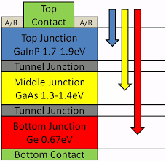
Multi-junction solar cell:
Multi-junction (MJ) solar cells are solar cells with multiple p–n junctions made of different semiconductor materials. Each material's p-n junction will produce electric current in response to different wavelengths of light. The use of multiple semiconducting materials allows the absorbance of a broader range of wavelengths, improving the cell's sunlight to electrical energy conversion efficiency.
Abstract:
To simulate the high efficiency CIGS(Cu(In,Ga)Se2) based Solar Cell using SCAPs 1D tool and analyze the influence of buffer layer on the CIGS-based Solar cell. Also PV parameters are calculated for different buffer layer (CdS,ZnS,ZnSe) and find the alternative of CdS. [Seminar Presentation]
To enhance the efficiency of earlier presented, CIGS based 3-layer MJ solar cell by inserting the novel back surface field (SnS) layer. Also, to analyze the effects of changing the width parameter for absorber, buffer and back surface field layer and to implement ZnS as buffer layer and establishing it as substitute for CdS. [Assignment Presentation]
Fig-1 MJ Solar Cell
Image Sources: Google Images

Slide 3
Introduction:
CIGS is important material for terrestrial based solar cells applications because of their high efficiency, long-term stable performance and potential for low-cost production. Thin film solar-cells with polycrystalline Cu(In,Ga)Se2 (CIGS ) absorber layers provide a good alternative to wafer based crystalline silicon solar cells, which currently constitute the major share of photovoltaics installed and used worldwide. The CIGS based solar cells exhibit excellent outdoor stability, radiation hardness and highest efficiencies (19.2%).
These compounds are direct bandgap semiconductors which minimize the requirement for long minority carrier diffusion lengths.
Such p-type semiconductors with high absorption coefficient are the promising absorbing materials for thin film photovoltaic technology.
Buffer layer is an intermediate layer film between the absorber and window layers with two main objectives,
A. to provide structural stability to the device &
B. to fix the electrostatic conditions inside the absorber layer.
Cadmium sulphide (CdS) is a prominent candidate to be used a buffer layer in Cu(In,Ga)Se2 based solar cell.
Note that Cadmium (Cd) is a metal that can cause severe toxicity in humans and the environment.
ZnO{n type}
Buffer layer(ZnS/CdS){n type}
CIGS(Absorber layer){p type}
SnS(Back field Layer){p type}
ZnO{n type}
Buffer layer(ZnS/CdS/ZnSe){n type}
CIGS(Absorber layer){p type}
Table-1: Shows 3-layers arrangement w/o SnS layer
[ Seminar Presentation]
Table-2: Shows 4-layers arrangement with SnS layer

Slide 4
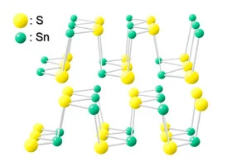
Properties of SnS:
SnS is a tin compound with desirable qualities such as non toxicity, low cost, and good hydrolytic stability.
SnS has been actively studied due to its p-type semiconductor characteristics and remarkable optoelectronic properties. Particularly, the low process temperature of the tin compound is a great advantage. The use of a low process temperature improves the process efficiency, prevents device degradation, and enables application on flexible substrates.
Crystallographically, SnS has a double-layered orthorhombic structure under usual process conditions, as shown in Figure 2. Atoms are covalently bonded in the planar layers, and individual layers are bonded by van der Waals forces. The orthorhombic structure has two carrier paths perpendicular to each other along the basal plane . One path has zigzag shape, and the other is called the armchair direction. In the case of physical properties, SnS films generally have a carrier concentration of 10^15 to 10^17 cm^(−3), carrier mobility greater than 15 cm^2/V-s, a strong absorption coefficient greater than 104 cm^(−1) in the visible region, and a bandgap of 1.25 eV.
SnS is a strong candidate material for various energy devices, such as solar cells, batteries, water splitting devices, and thermoelectrics, due to the excellent optoelectronic properties and stable p-type characteristics
Fig-2 SnS Structure
Image Sources: Google Images

Slide 5
Importance of having SnS as BSF(back surface field layer):
The BSF layer has a role of the creation of a retarded electric field on the back face which permits the decrease of the effective value of the speed of recombination and therefore improve the electrical characteristics of the solar cell .
Thus, adding an electric field in the vicinity of the ohmic contact at the rear surface, makes the minority carriers be pushed towards the space charge zone for a better collection . An improvement is obtained on the current-photon open circuit voltage and photovoltaic conversion efficiency.
The low band-gap material (SnS) is inserted as BSF layer between the absorber layer and the back contact to reduce the barrier height, and to make possible recombination loss at the back contact of the ultra thin CIGS cell.
The SnS layer serve as a BSF to reflect back the carriers (electrons) from the CIGS junction and thus would contribute in the enrichment of carriers.

Slide 6
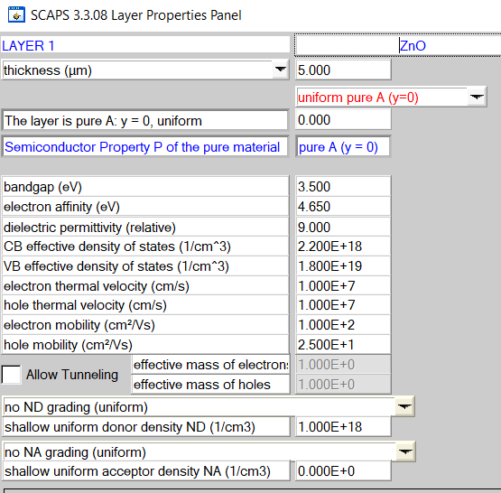
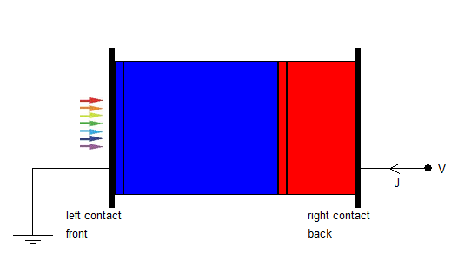
Properties:
Fig-3: Diagram for 4-layer MJ Simulated CIGS based Solar Cell, First layer is ZnO, then Buffer layer(ZnS/CdS) then CIGS layer, SnS layer(moving from left to right).
Fig-4 : Properties of ZnO layer . N-type surface. Also, this layer will have direct light contact

Slide 7
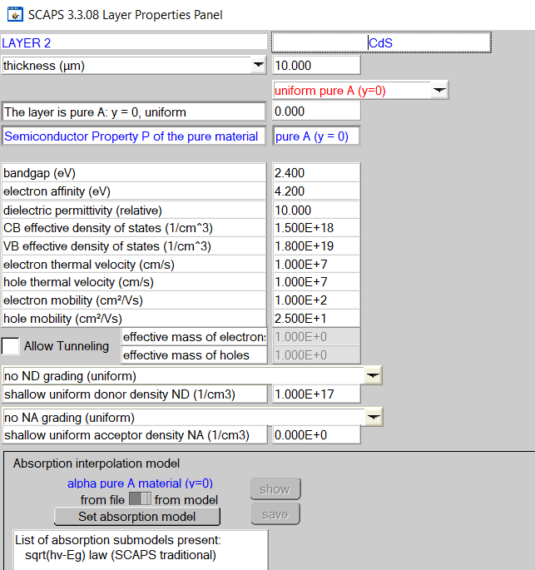
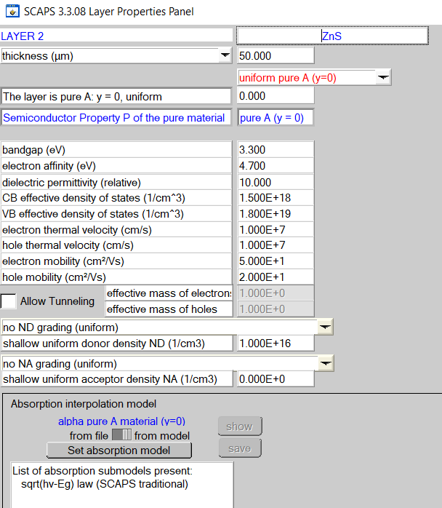
Fig-5 : Properties of CdS layer . N-type surface. This layer is called as buffer layer.
Fig-6 : Properties of ZnS layer . N-type surface. This layer is called as buffer layer.

Slide 8
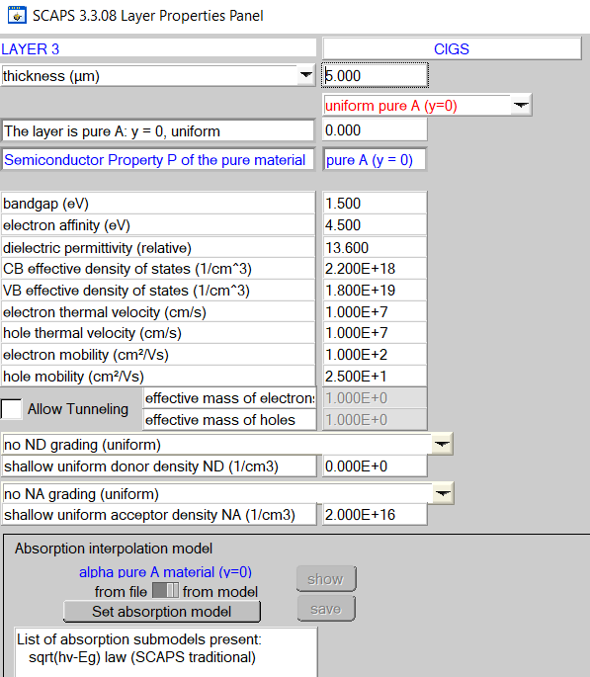
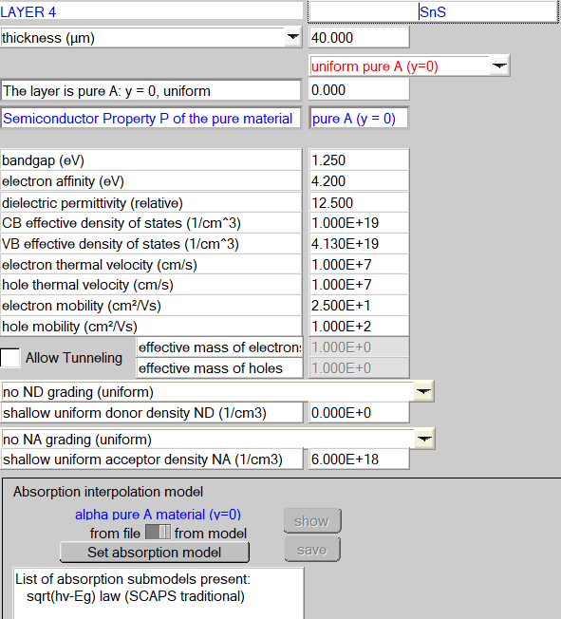
Fig-7 : Properties of CIGS layer . P-type surface.
This layer is called as absorber layer.
Fig-8 : Properties of SnS layer . P-type surface.
This layer is called as Back field layer.

Slide 9
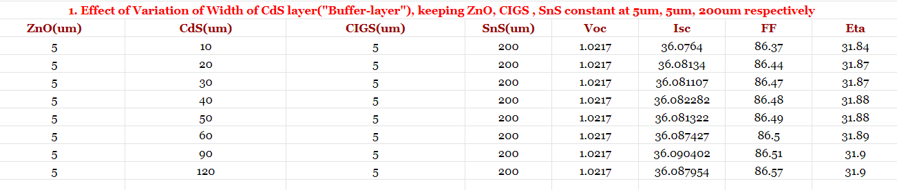
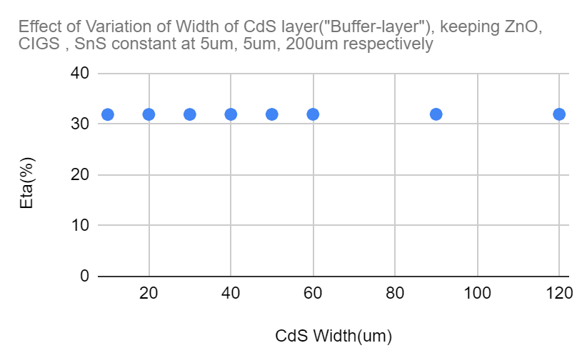
Experimental Results:
Fig-9 : Experimental result on eta vs width of CdS from 10 um to 120 um, shows that eta is almost constant . We can see that by adding SnS layer, the efficiency got boosted by 7-8% which shows the benefit for having MJSC.

Slide 10
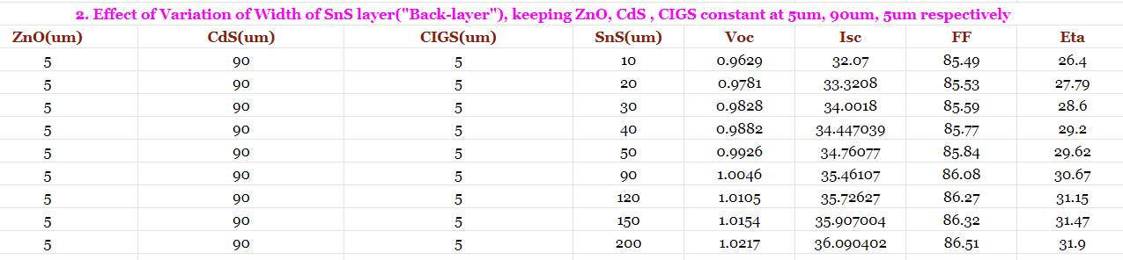
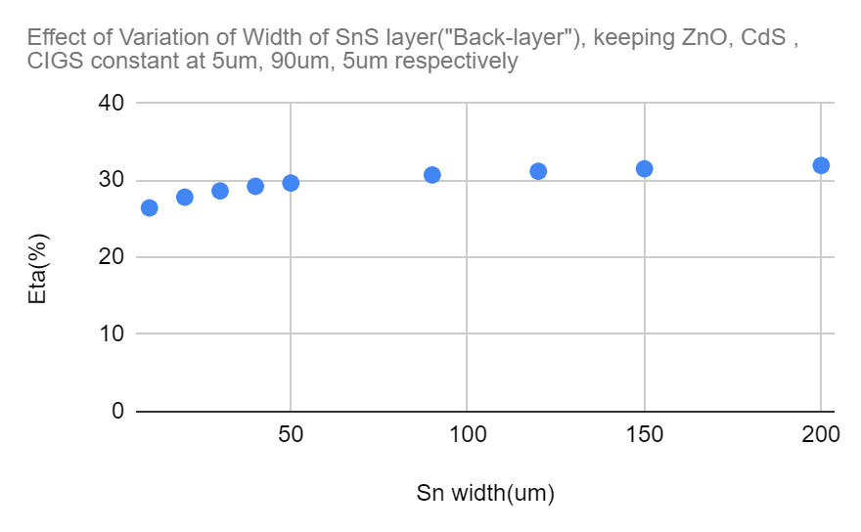
Fig-10 : Simuolation result on eta vs width of SnS varied from 10 um to 200 um, shows that eta enhancement is almost 6-7%. The eta efficiency is very observable and still for ultra thin efficiency is above 26% which is really good and can be implementable where we need to have minimum area. However, fabricating upto 200 um which is as similar to size of crystalline Si SC, and efficiency got boosted by 8-10%

Slide 11
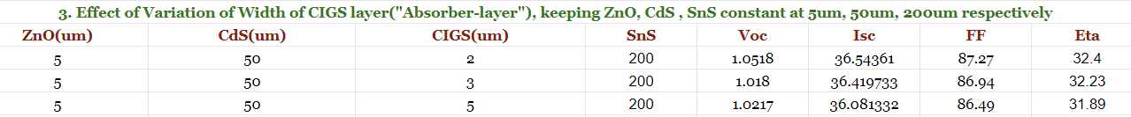
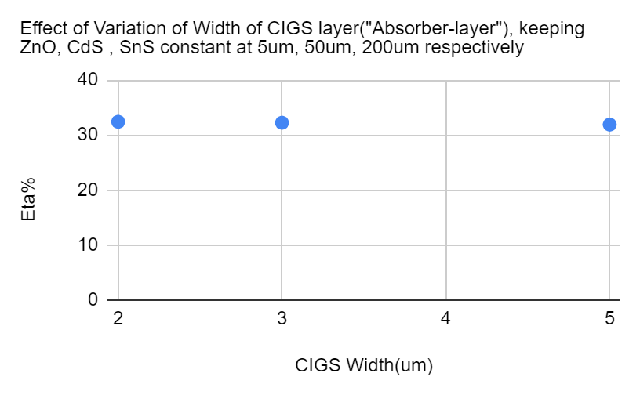
Fig-11: Experimental result on eta vs width of CIGS(absorber layer) with CdS as buffer layer, shows that eta enhancement is almost 0.7% . Increase in eta is observable however it is not drastic. We can also see that for 2um we have maximum efficiency out of these 3 cases, which shows benefit of having ultra thin CIGS to enhance the efficiency. However precision of fabrication in labs matter most so we may have to choose sizing effectively depending upon application.

Slide 12
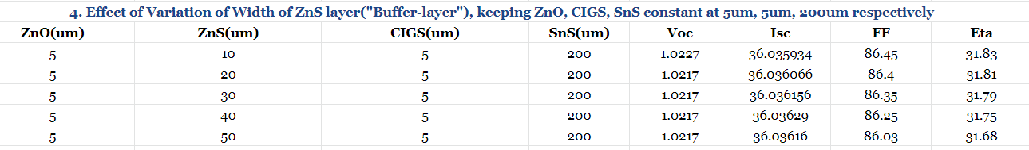
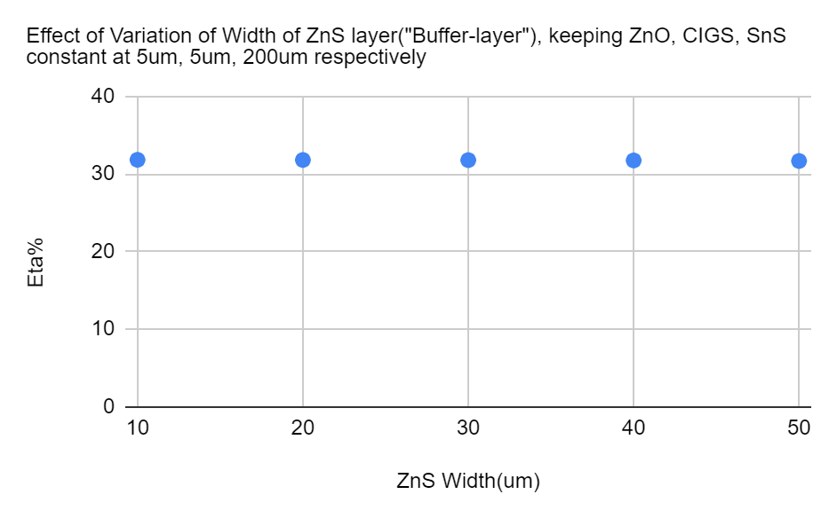
Fig-12 : Experimental result on eta vs width of ZnS(buffer layer), shows that eta is almost constant. Eta practical value is around that of CdS. Hence it is good substituting material for CdS.
Note: Cd is highly toxic in nature for human as well as environment.
As similar to case 1, We can see efficiency got boosted by around 7-8%, which can be generated by adding SnS layer of 200 um.

Slide 13
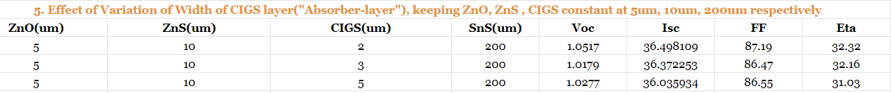
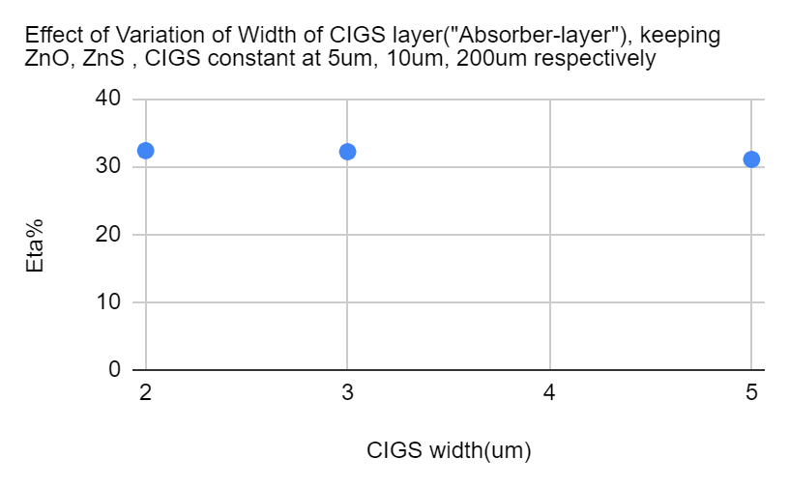
Fig-13 : Experimental result on eta vs width of CIGS(absorber layer) with ZnS as buffer layer, shows that eta enhancement is almost 0.3% . Increase in eta is observable however it is not drastic. We can also see that for 2um we have maximum efficiency out of these 3 cases, which shows benefit of having ultra thin CIGS to enhance the efficiency. However precision of fabrication in labs matter most so we may have to choose sizing effectively depending upon application.

Slide 14
Result: Simulated the 4 layer MJ Solar cell and plotted the efficiency vs Width for various cases. By inserting SnS as back field surface layer, the efficiency got boosted significantly. Also with this we can reduce the width of CIGS to make it ultra thin.I chose CdS as buffer layer initially and wanted to find substituting material for CdS due to its toxic nature without compensating the efficiency, Hence found the material ZnS which is good material for environment , easy to manufacture and non-toxic in nature as well with almost same efficiency.
Conclusion:
In this investigation, I studied the performance of the CIGS-based solar cells. The CdS buffer layer is replaced by other materials like Zinc Sulphide (ZnS) and Zinc Selenide (ZnSe). We concluded that ZnS can be used as alternative material to CdS to attain almost same efficiency.
Multi junction Solar cells , if properly fabricated along with optimum design and best material selection without causing any ill effect on environment can serve potential source of renewable energies, with better efficiency rates.
A. With CdS as buffer layer, max efficiency I found was 32.4% when ZnO: 5um, CdS: 50um, CIGS: 2um, SnS: 200um.
B. With ZnS as buffer layer, , max efficiency I found was 32.32% when ZnO: 5um, CdS: 50um, CIGS: 2um, SnS: 200um.
In summary, a novel back surface field (BSF) SnS layer has been inserted ,the results show that the structure with the layer BSF (ZnO/(CdS/ZnS)/CIGS/SnS) in the cell gives an efficiency upto 32.5%% . This also improves the electrical efficiency with respect to earlier reported ones and reduces the cost due to the reduction of the thickness of the absorber layer.

Slide 15
References:
https://en.wikipedia.org/wiki/Multi-junction_solar_cell
Repins I, Contreras M, Egaas B, DeHart C, Scharf J, Perkins C, To B, Noufi R. 19.9%-efficient ZnO/CdS/CuInGaSe Solar cell with 81.2% fill factor. Prog Photovolt Res Appl, 2008, p 235–239.
J.Lindahl , U.Zimmermann , P.Szaniawski , T.Törndahl , A.Hultqvist , P.Salomé , C.Platzer-Björkman and M.Edoff , Inline Cu(In,Ga)Se2 Co-evaporation for high efficiency solar cells and modules IEEE J.Photovolt , 2013, p1100–1105.
M.Powalla , P.Jackson , W.Witte , D.Hariskos , SPaetzle , C.Tschamber and W.Wischmann , High-efficiency Cu(In,Ga)Se2 cells and modules Solar Energy Mater. Solar Cells,2013, p 51–58.
A.Chirila et al , Highly efficient Cu(In,Ga)Se2 solar cells grown on flexible polymer films , Nature Mater, 2011, p 857–861.
The role of back surface field SnS layer in improvement of efficiency of CdTe thin film solar cells Sabrina Benabbasa), Zahir Rouabaha), Nadir Bouarissab) , Nacereddine Chelalia) .
Enhancing the efficiency of CIGS thin film solar cells by inserting novel back surface field(SnS) layerS. Benabbas , H. Heriche, Z. Rouabah, N. Chelali.
Thank You
For your support

